Slide 1
Capital In the 21st century
Jerome
Duluk

Slide 2
Two main points
The return of a patrimonial (or wealth-based) society in the Old World (Europe, Japan). Wealth-income ratios seem to be returning to very high levels in low growth countries. Intuition: in a slow-growth society, wealth accumulated in the past can naturally become very important. In the very long run, this can be relevant for the entire world.
The future of wealth concentration: with high r - g during 21^{c} (r = net-of-tax rate of return, g = growth rate), then wealth inequality might reach or surpass 19c oligarchic levels; conversely, suitable institutions can allow to democratize wealth

Slide 3
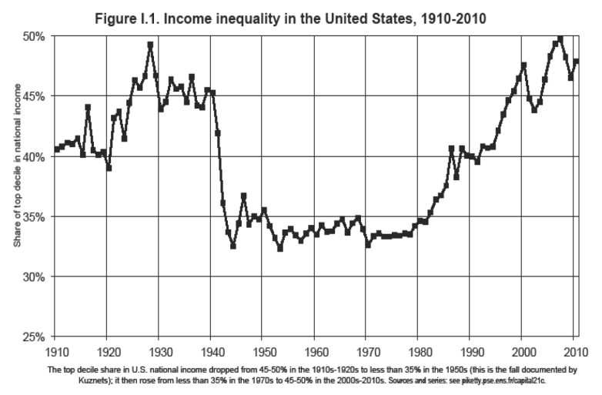
Inequality in The united states

Slide 4
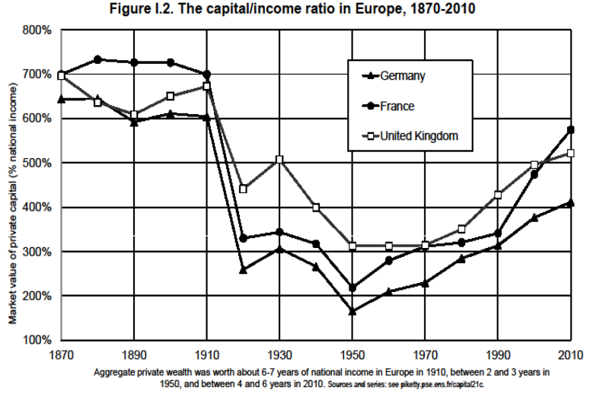
Inequality in europe

Slide 5
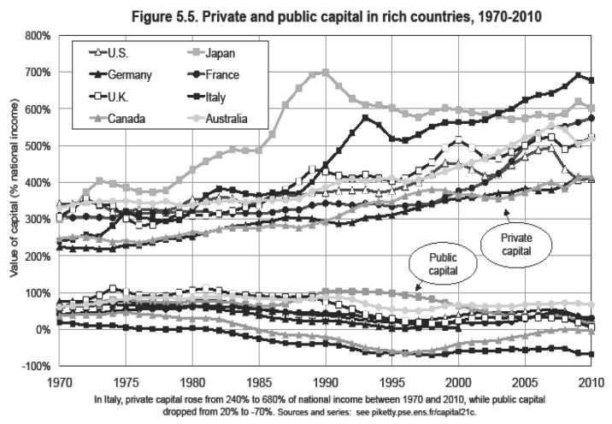
Private vs public capital

Slide 6
Importance of wealth accumulation
Simple long-run model example:
s = savings rate (net of depreciation)
g = economy’s growth rate (population and productivity)
β = s/g (pure stock flow accounting identity)
Example 1
s = 10%
g = 3%
β = 300%
In slow growth societies, the total stock of wealth accumulated in the past becomes very important
Example 2
s = 10%
g = 1.5%
β = 600%

Slide 7
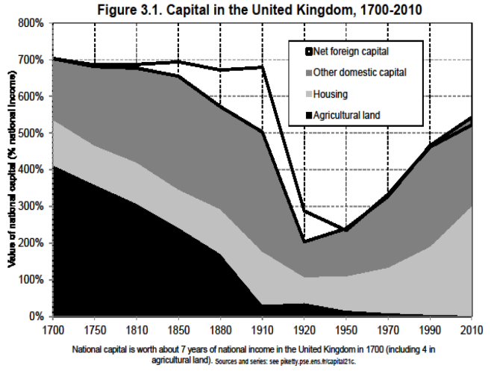
Example: the United Kingdom

Slide 8
Theory: CAPITAL-INCOME RATIO (β)
Will an increase in β lead to an increase in capital’s share (α) of national income?
If the capital stock equals β=6 years of income and the average return to capital is equal r=5% per year, then the share of capital income (rent, dividends, interest, profits, etc.) in national income equals:
α = r x β = 30%
Whether a rise in β also leads to a rise in capital share α = r β depends on the elasticity of substitution σ between capital K and labor L in the production function Y=F(K,L)
Assume Cobb-Douglas production function (σ=1)
Piketty describes the “magic” involved in a society where the capital-labor split is set entirely by technology
= as the stock β↑, the return r↓ exactly in the same proportions

Slide 9
Reality: CAPITAL-INCOME RATIO (β)
If σ>1:
The return to capital r⬇ falls less than the volume of capital β⬆
The product α = r x β ⬆
What happened during the 1970s-80s?
Both the ratio β and capital share α have increased
With a large rise in β, you can get large rise in α with a production function F(K,L) that is slightly more substitutable than in the standard Cobb-Douglas model (e.g. if σ=1.5 instead of 1)
Is it natural to expect σ to increase over the course of human history?
Piketty offers an extreme case where σ = infinity, which is an example of a purely robotic economy
Less extreme case: there are many possible uses for capital (machines can replace cashiers, drones can replace Amazon’s delivery workers, etc.), so that the capital share α⬆ continuously

Slide 10

Who owns the robots?
In the previous example, it is easy to see how increasing automation can give way to a culture-based society
People do not have to work, so they devote time to culture, education, health, rather than subsistence
Robots slowly replace different kinds of labor until jobs effectively become obsolete for humans
The only question one needs to
answer is: who owns the robots?

Slide 11
Future of wealth concentration
Historically: Wealth concentration was extremely high in 18^{c}-19^{c} and until WWI
About 90% of aggregate wealth for top 10% wealth holders
About 60% of aggregate wealth for top 1% wealth-holders
= the classic patrimonial (wealth-based) society: a minority lives off its wealth, while the rest of the population works
Today: wealth concentration is still very high, but less extreme
About 60-70% for top 10%
About 20-30% for top 1%
The bottom 50% still owns almost nothing (<5%)
BUT the middle 40% now owns 20-30% of aggregate wealth
= The rise of a patrimonial middle class

Slide 12
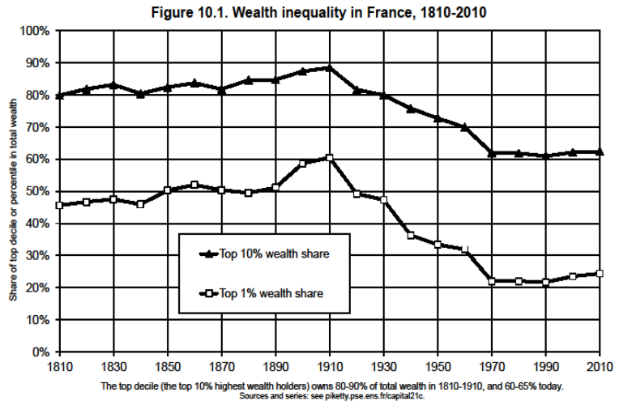
Example: France

Slide 13
A few main questions
Q: Apart from shocks, what forces determine the long-run level of wealth concentration?
In any dynamic, multiplicative wealth accumulation model with random individual shocks (tastes, demographic, returns, wages,..), the steady-state level of wealth concentration is an increasing function of r – g
With growth slowdown and rising tax competition to attract capital, r - g may rise in the 21^{c} → back to 19^{c} levels
Future values of r also depend on technology (σ>1)

Slide 14
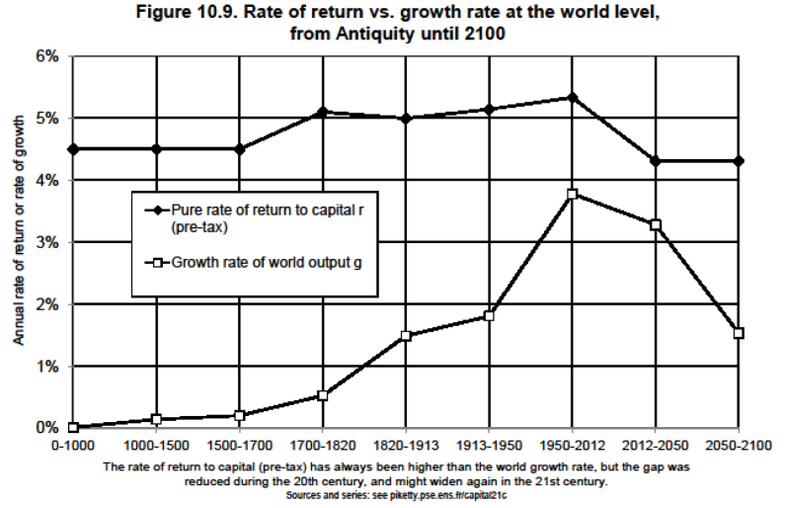
So what would that look like?

Slide 15
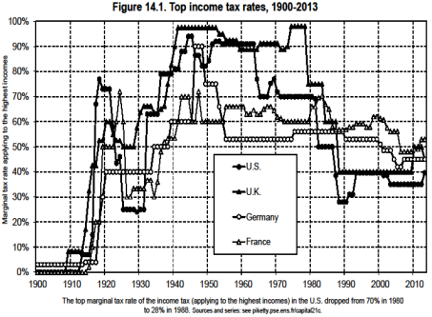
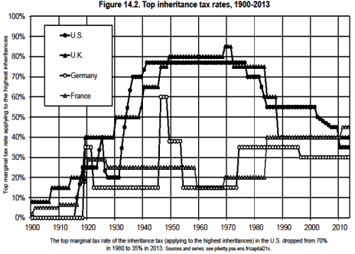
How do we solve this problem?
Progressive wealth tax on a global scale:
Tax on capital and capital gains
Inheritance tax (reducing wealth accumulation in families)
Key assumption: automatic exchange of bank information

Slide 16
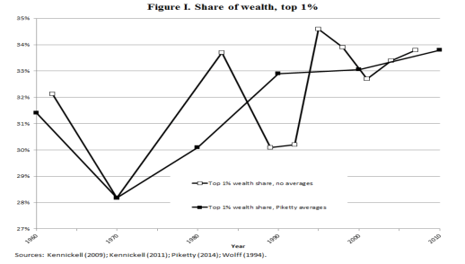
critiques
Main point of emphasis: Data methodology
Many economists point out how Piketty compiled data from different sources (even 18^{c} books), and economists doubt the validity. He averages many growth and income inequality figures across time to present data in a clean form, which may skew the results
In response, Piketty states that even a 10% error in the data will not significantly change the conclusions of his book

Slide 17
Critiques
The relationship r vs. g
“A key to effective communication is one’s ability to distill complex issues into simple ones. In Capital, the relationship between the return to capital, r, and the economic growth rate, g, is presented as a fundamental relationship determining our economic path, and both theory and historical evidence are mustered to bolster the claim that r > g is an inevitable outcome.” (Auerbach and Hasset, National Bureau of Economic Research, 2015)
Is r calculated correctly?
Risk-free rate of return (r^{f}) vs. market rate of return (R)
Risky and risk-averse investors

Slide 18
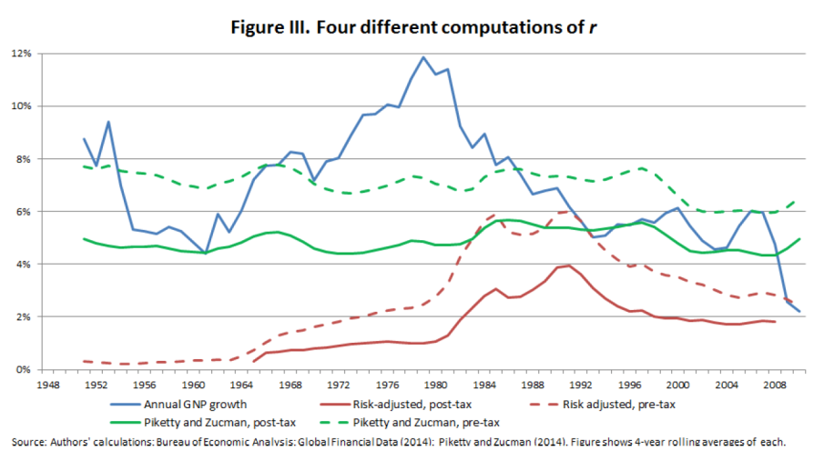
Calculating the rate of return

